Slide 1



400 TO 6000 ONLY
Galaxy Footware Group

Slide 2
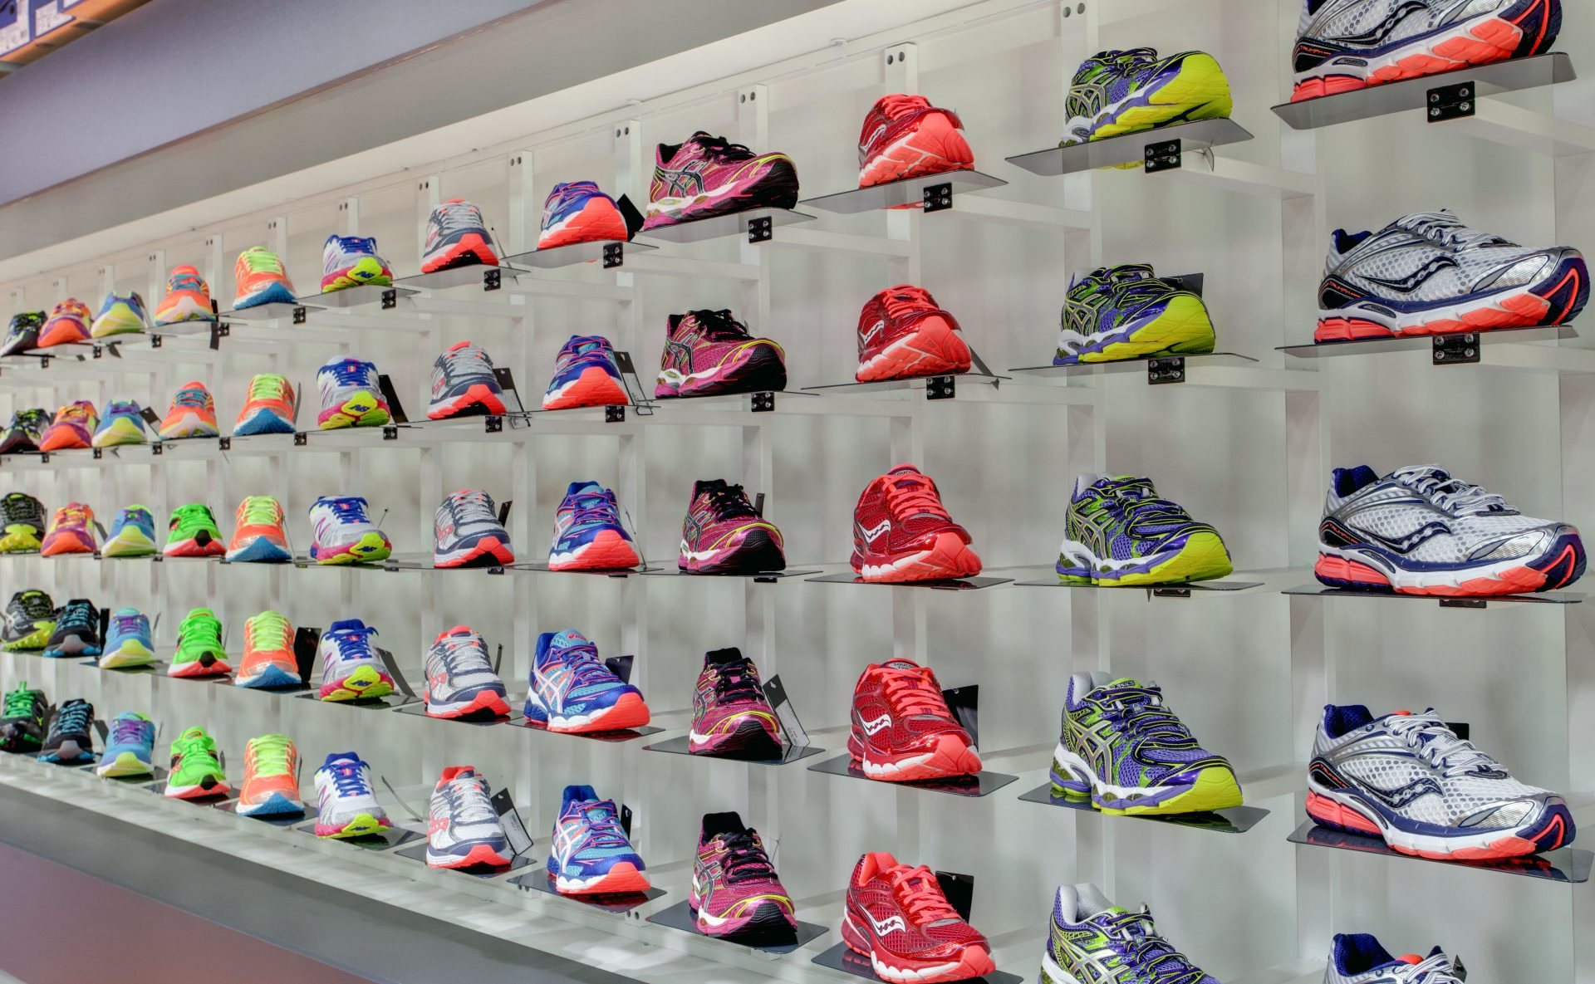

Agenda
Sales Maximization
Quantity
Lower Price
Branding
Chain-Retail Showrooms

Slide 3
Introduction
Galaxy Footware is a Chain-Retail footwear showrooms with wide varieties of footwear items.
Many varieties of items of gents, ladies and kids are available in a showroom.

Slide 4
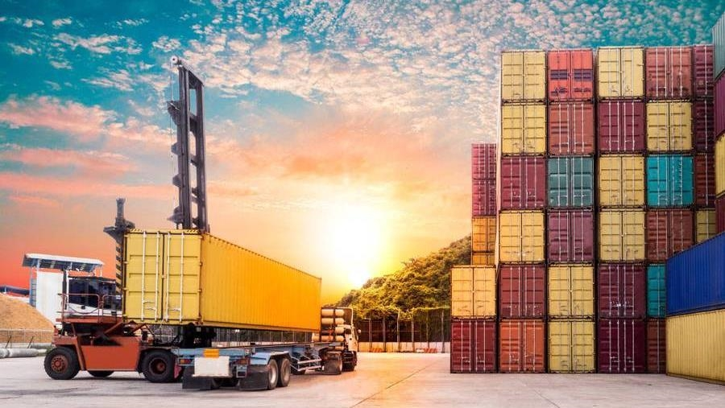
Business Model
Subtitle

Slide 5
Quantity
Varieties for Gents, Ladies and Kids
Sales Maximization
Lower prices on quantity
Company with its branches over country

Slide 6
Sales by variety
In Lakhs

Slide 7

The way to get started is to quit talking and begin doing.
Walt Disney
2023

Slide 8
Timeline
Planning
Just came idea on 15th June 2022
Market Visit
Random walkdown on New Road street for market visit
Two Retails
17th July on Bhairahawa
21st July on Butwal
Company Office
8th September 2022
Showroom Expansion
24th September Onwards

Slide 9
Advertisement
Facebook
TikTok
Video Boosting
Slow Photo Boosting
Page Update
Regular Video Posting
Repeat Content
YouTube
Instagram

Slide 10


THANK YOU
Presenter name
Email address
Website

